Slide 1

Ising model
By:
Isaac Pliskin
Shahriar Keshvari
Luis Argueta
Tianing Wang
Yongxiao Yan

Slide 2
Description Of Ising Model Code
For all simulations, each temperature was found with 10 averages except for 20X20 matrix which we did the averages over 5 cycle.
We ran a filter through the values of the average energy to create a smooth curve. This caused sharp changes in the specific heat graph due to denoising of the data.
To extract a critical exponent, we used the graph for specific heat and the max value was found to be the critical temperature. This value was plugged in to the given equation in Lecture Notes #14 to extract a critical exponent. Using the specific heat graph gave us consistency in the value for critical exponent rather than using the sigma bar vs temp graph.
At last, we skipped the 64X64 matrix calculations since our code was not efficient enough to run. However, there are ideas to implement which we could not include due to the time constrain.

Slide 3
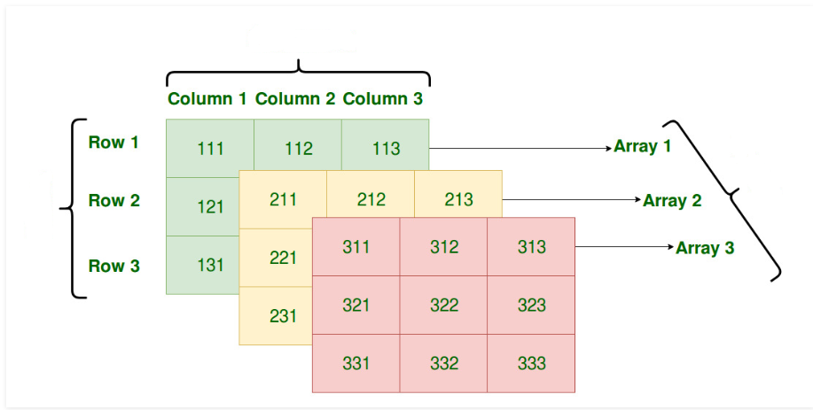
Number of Ensemble
Temperature
Evolution of every ensemble

Slide 4
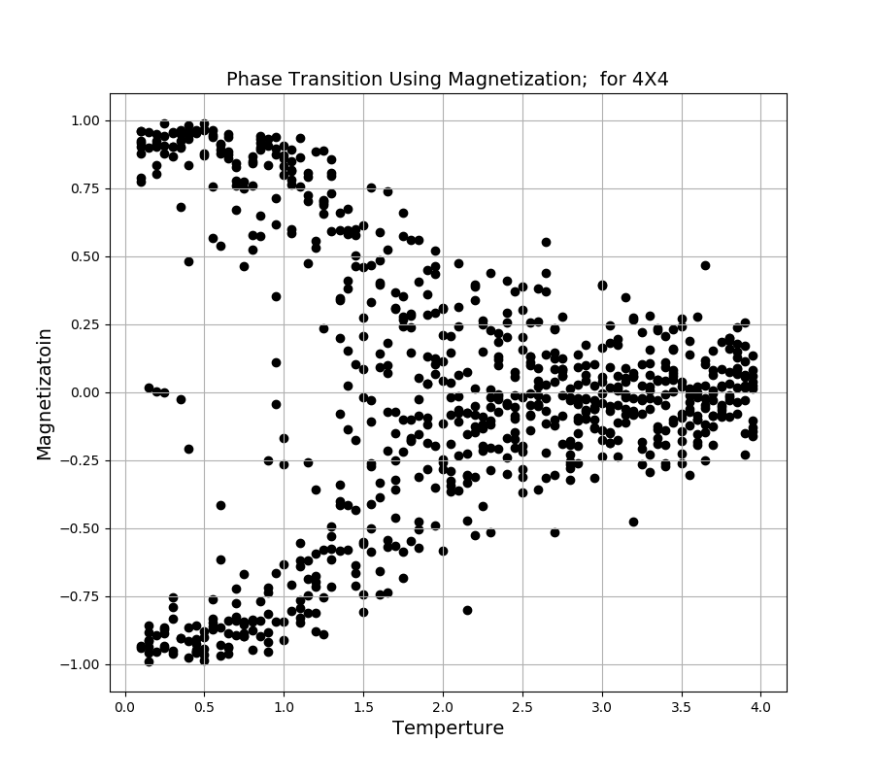

Slide 5
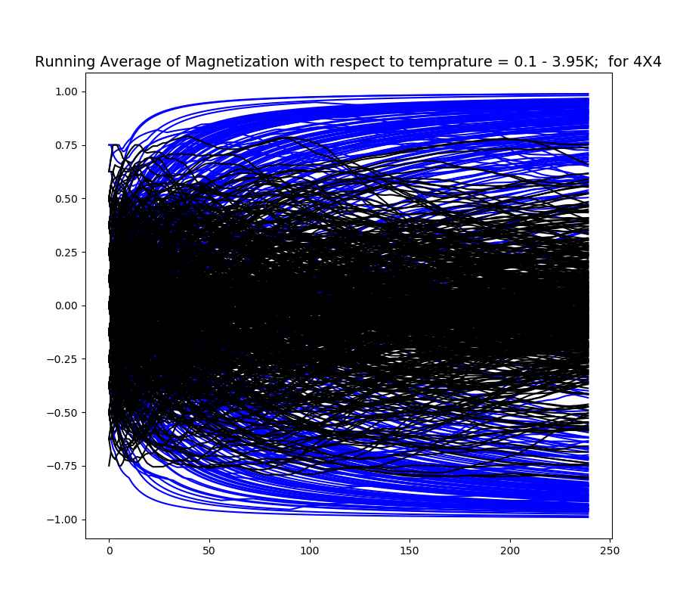
Black represents the Running Average of Magnetization for T>Tc
Paramagnetic
Blue represents the Running Average Magnetization for T<Tc
Ferromagnetic
Compared to the previous plot which contains only negative values, this graph contains both negative and positive values.

Slide 6
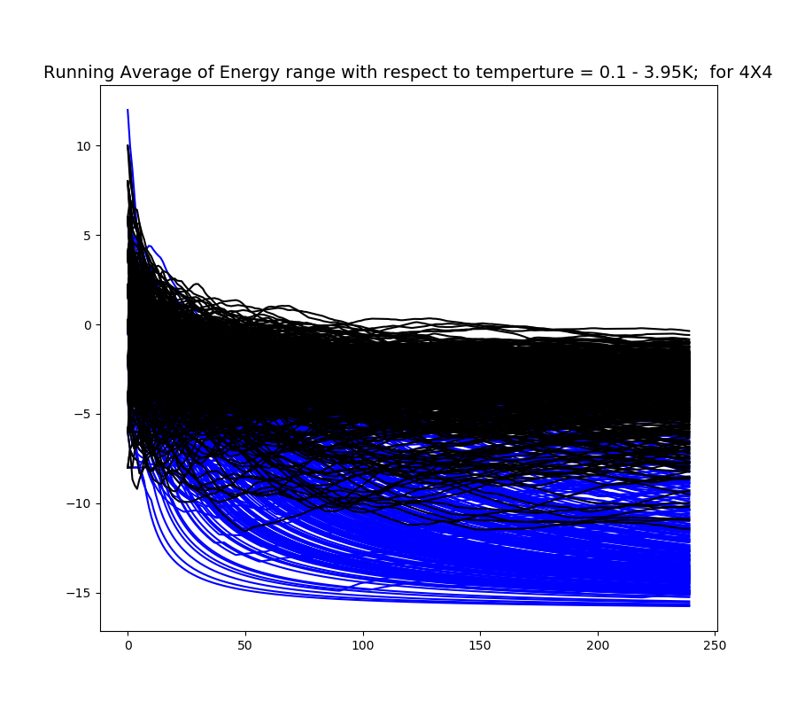
Black represents the Running Average of Energy for T>Tc
Blue represents the Running Average Energy for T<Tc
Notice that there is always overlap.
Notice that at very low temperature some of the blue curves are plunging down Immediately to zero.

Slide 7
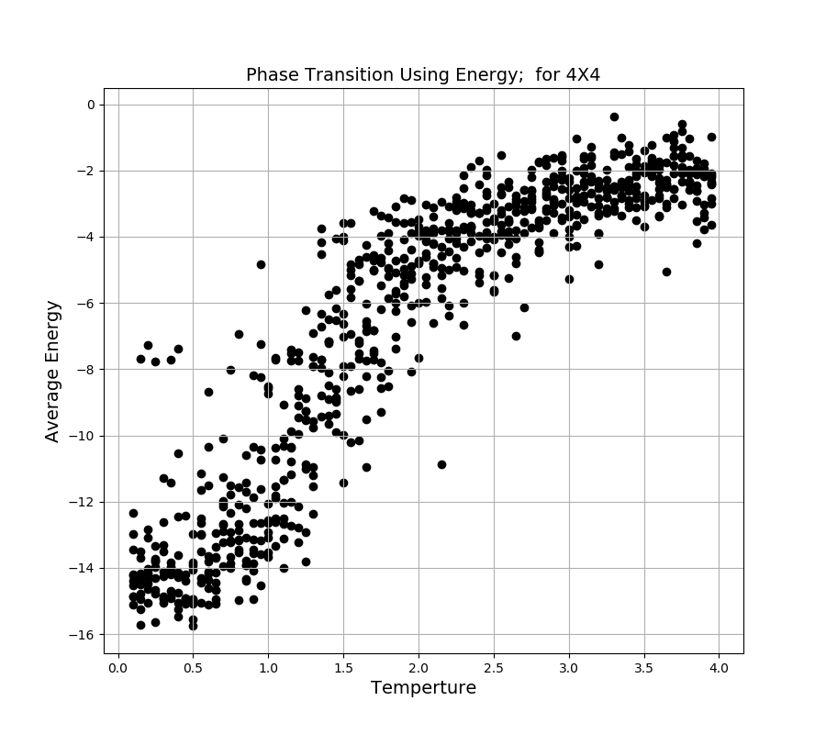

Slide 8
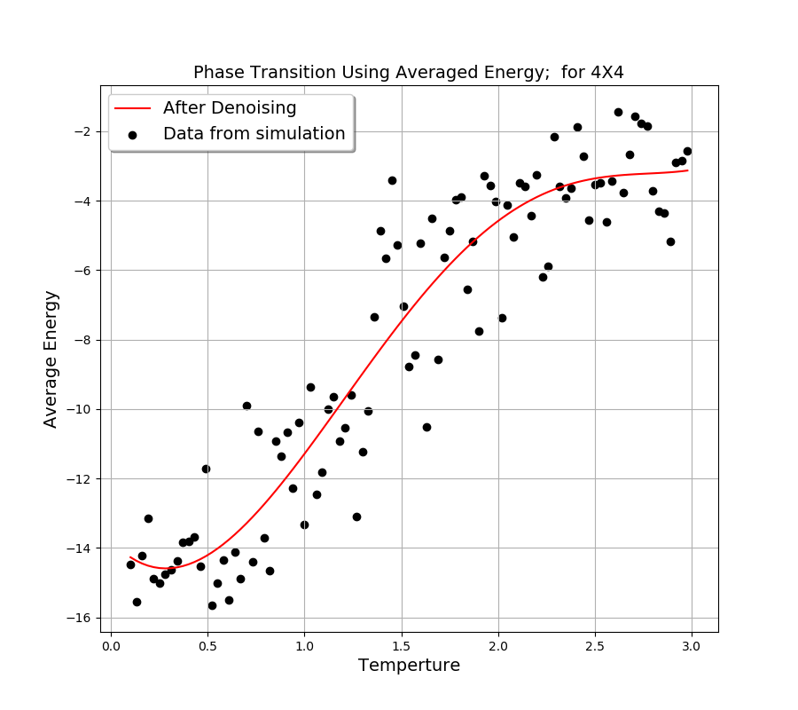
Each point is the Vertical average of the points from the average energy graph versus temperature.

Slide 9
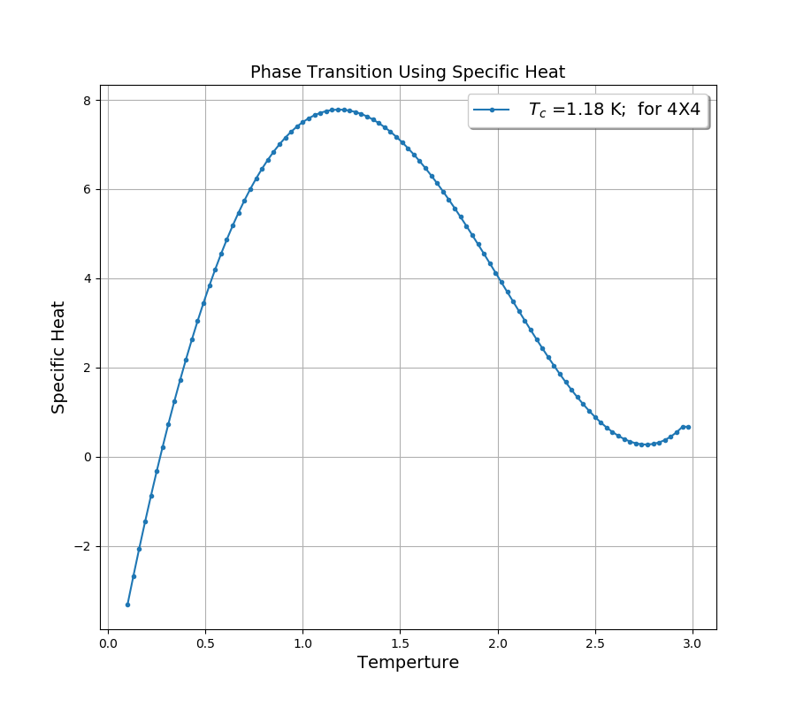
The point were achieved by taking the derivative of the fitted line from after denoising.

Slide 10
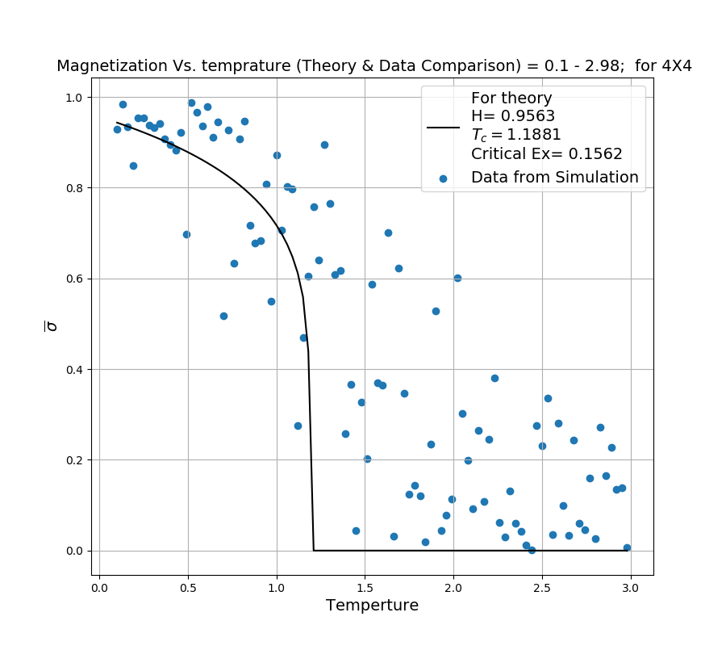

Slide 11
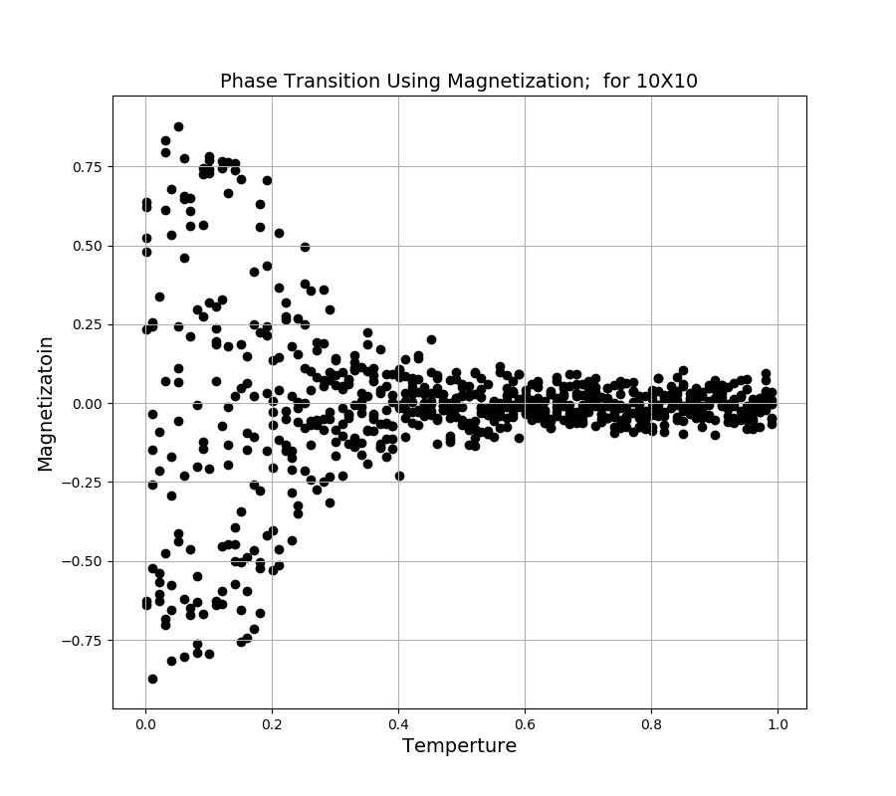

Slide 12
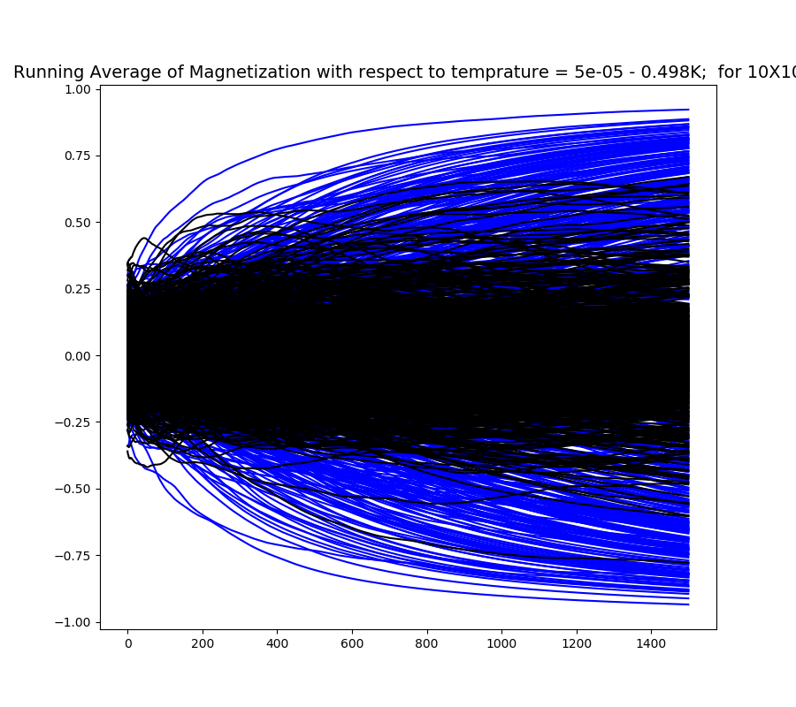

Slide 13
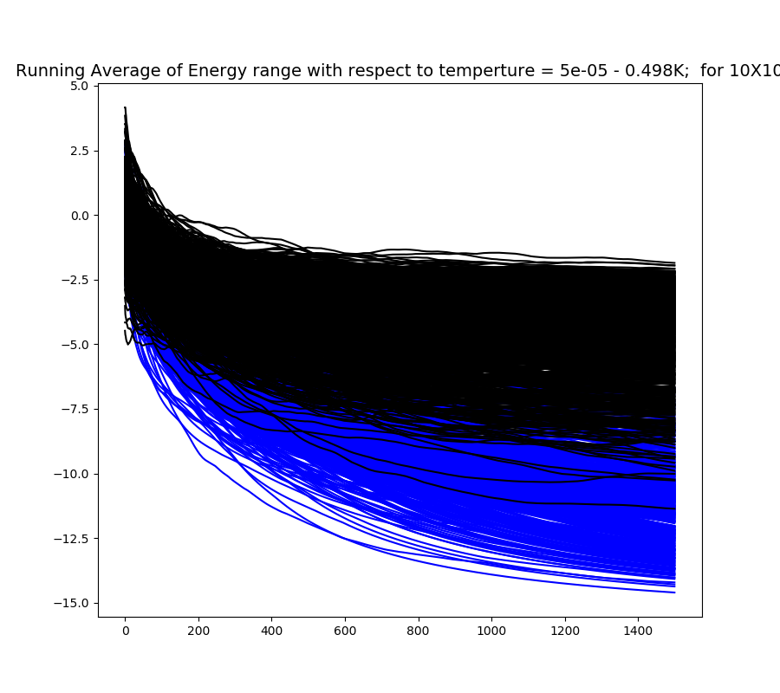

Slide 14
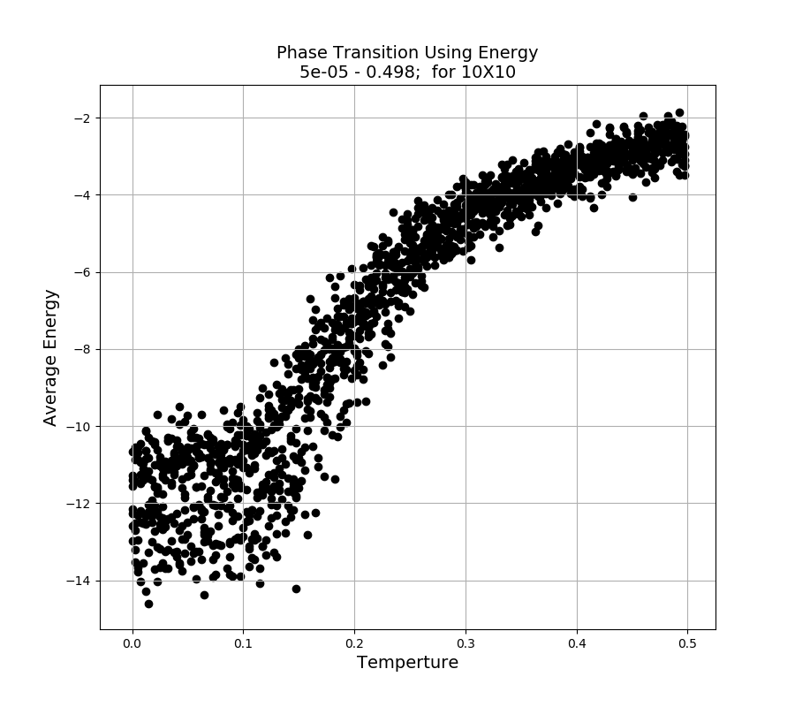

Slide 15
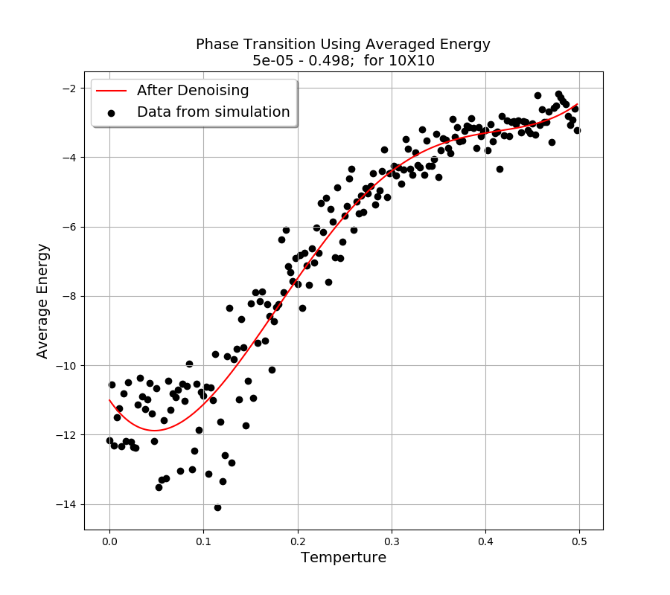

Slide 16
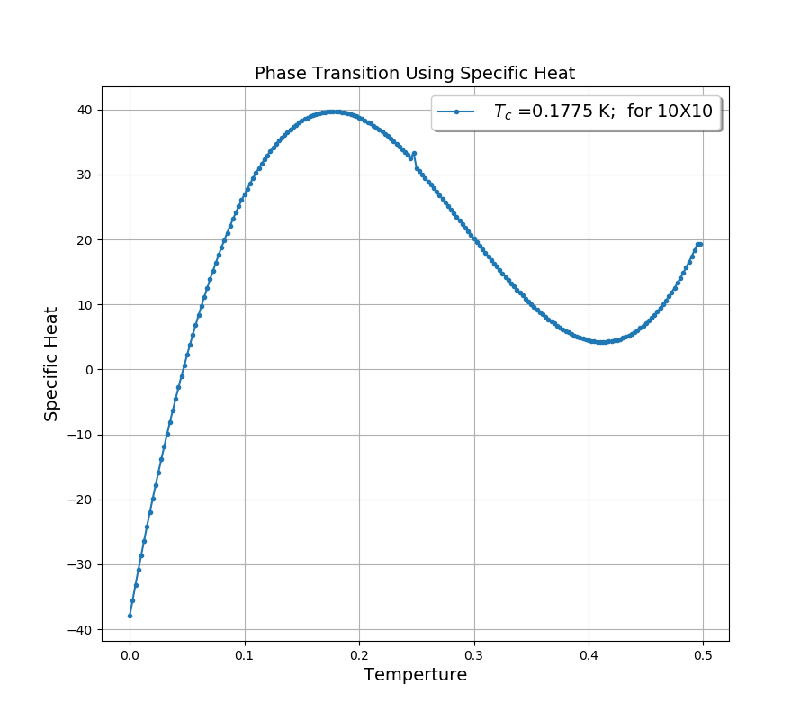

Slide 17
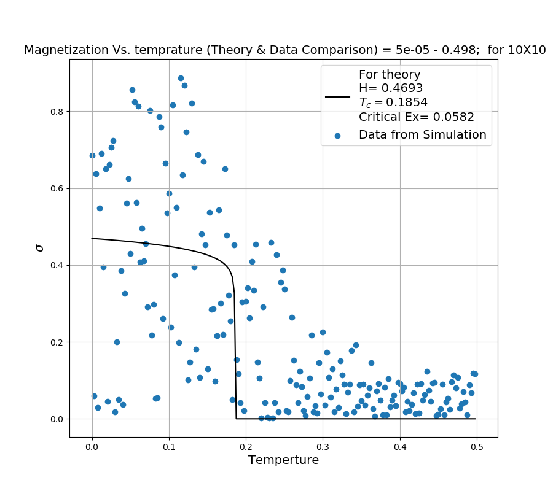

Slide 18
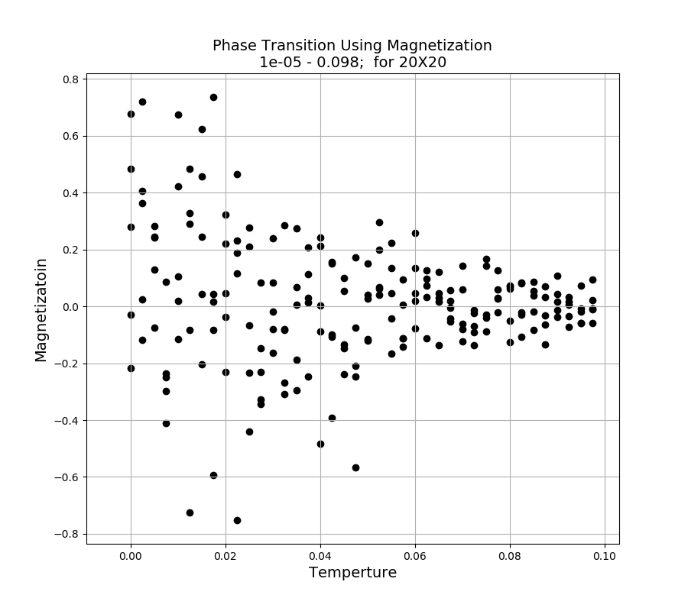

Slide 19
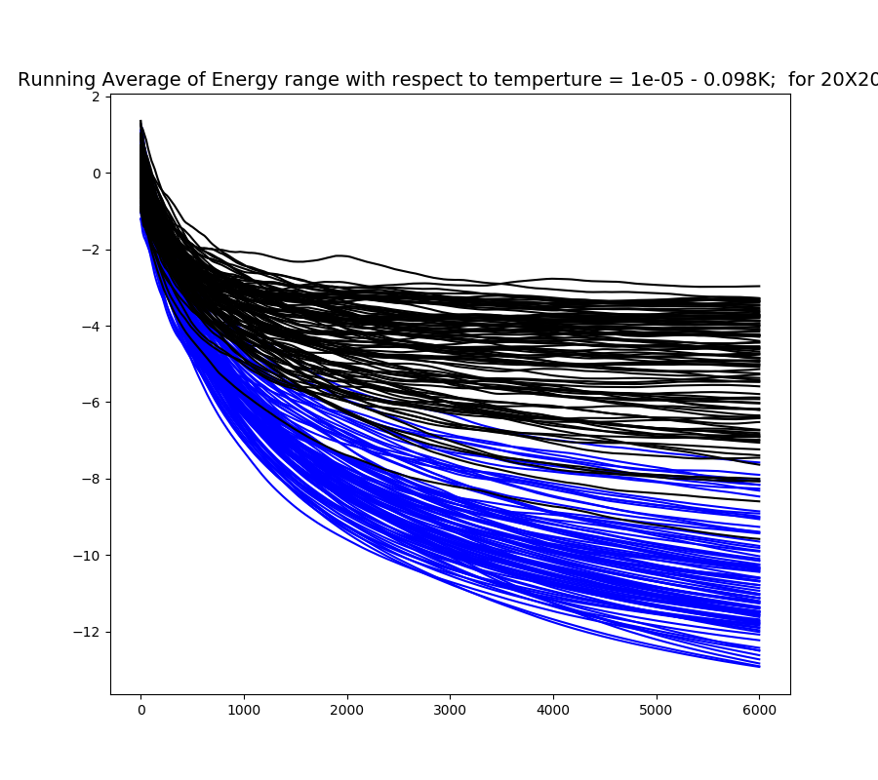

Slide 20
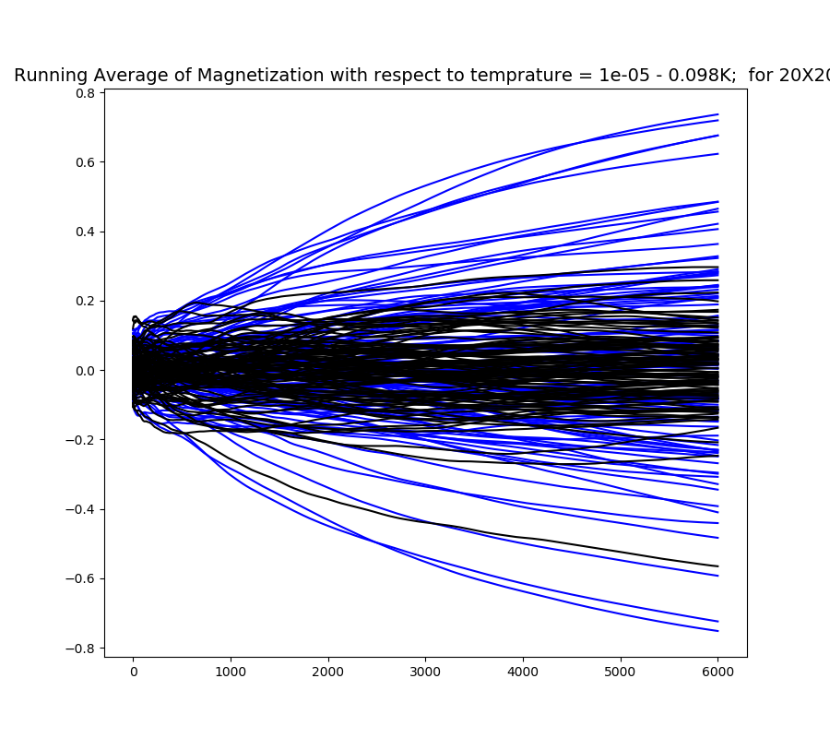

Slide 21
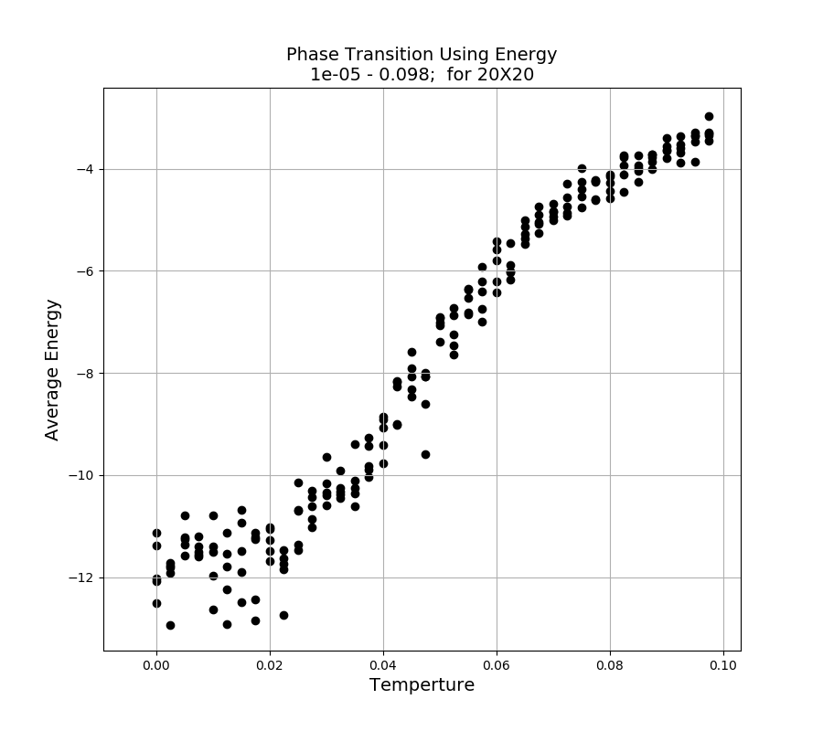

Slide 22
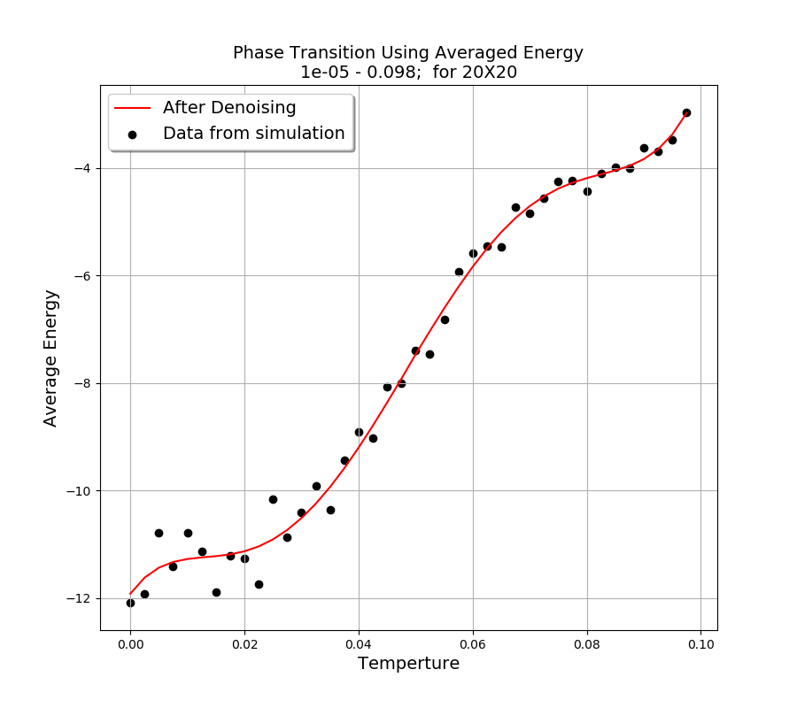

Slide 23
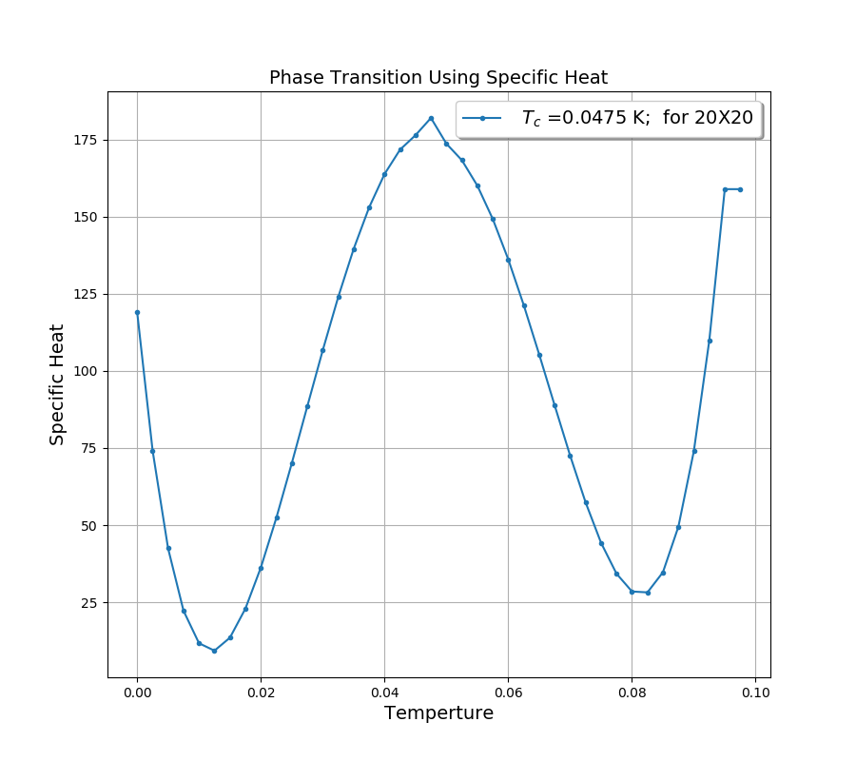

Slide 24
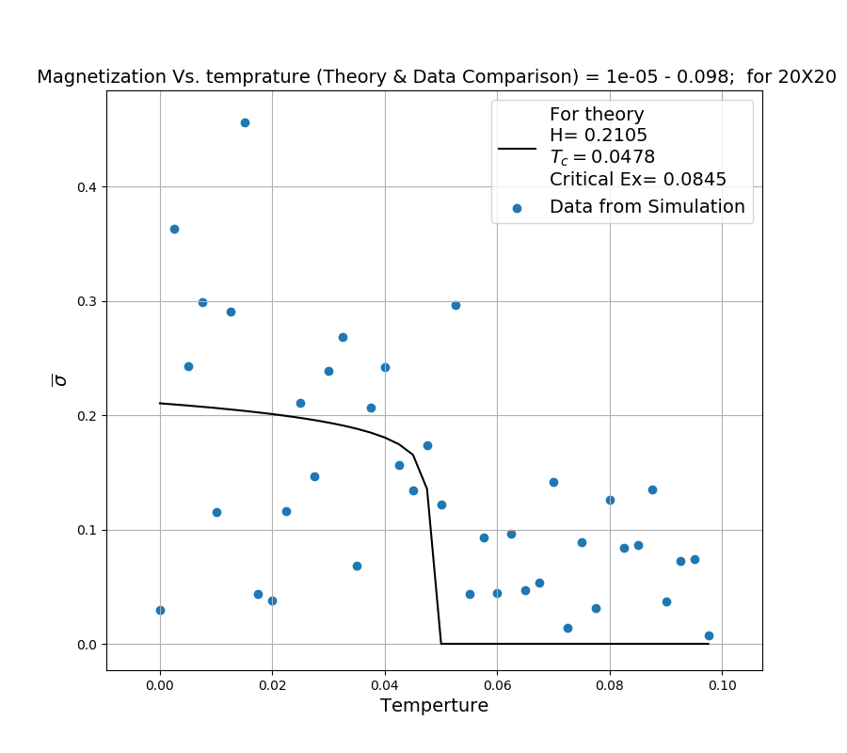

Slide 25
Improvements:
To impalement a new function to calculate the change in energy rather than going through the entire matrix to find energy. Currently For a 40X40 matrix a total of 2 minutes is required to calculate each points.
To save the final matrix of data for every run and write a code to read that file.
Adding external magnetic field to observe the how the system will evolve.
Finding a better filtering algorithm to create a much more smother curve to calculate critical exponent and temperature.
Remarks :
Odd Value for filtering
Fitting might not converge (Not enough points or sharp changes in data

